Slide 1

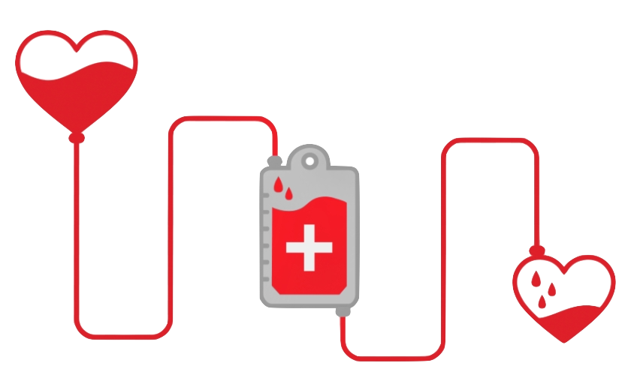
Blood Donation Shortage Prediction
Thip Rattanavilay,
DSC 630 – Predictive Analytics
Bellevue University

Slide 2

INTRODUCTION & PROBLEM STATEMENT
Most of us have donated blood at least once in our lifetime.
How often do you return to donate in order to save more lives?
Blood Banks problem is supply and demand.
There are variety of factors that impact the blood donation is repeat donations.
This project uses a dataset with various features about the donation being made the attempt to predict blood donations.
This will be useful in targeting the people who are interested in donating blood, which results in getting more volunteers to save more lives.

Slide 3
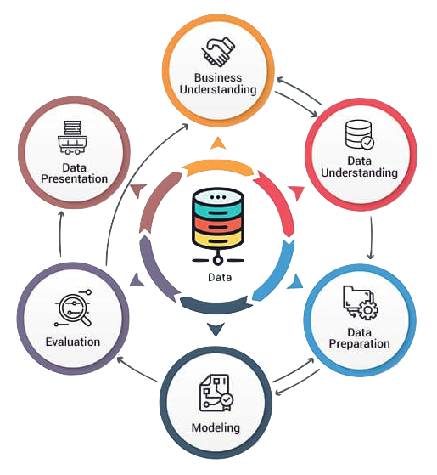
METHOD & STEPS
Understanding the business
Data understanding
Exploratory analysis of the dataset
Data cleaning and preparation
Split the data set into train and test set
Training and Test the models
Feature selection
Model evaluation
Discuss the best Model deployment

Slide 4
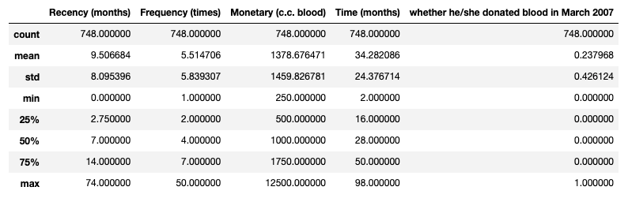
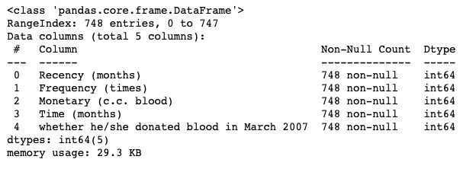
DATA UNDERSTANDING & EXPLORATORY DATA ANALYSIS
The dataset used in this analysis is from UCI.
Inspecting the transfusion data frame from March 2007.
This data frame has 748 rows and 5 variables.
Key variables are
Recency months
Frequency times
Monetary c.c blood
Time months
Whether he/she Donated blood in March 2007
Want to split the transfusion into train and test dataset
Correlation between features
Probability Distribution Curves
Feature Importance
Train the model

Slide 5

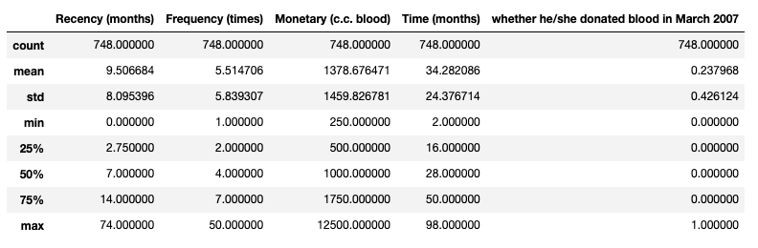
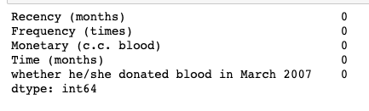

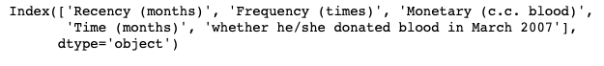
DATA PREPARATION & CLEANING
Inspecting transfusion dataset
Checked the data frame for null, or missing value

Slide 6
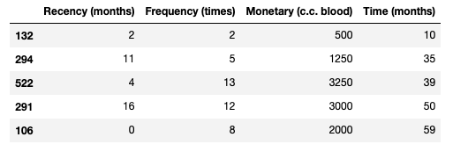
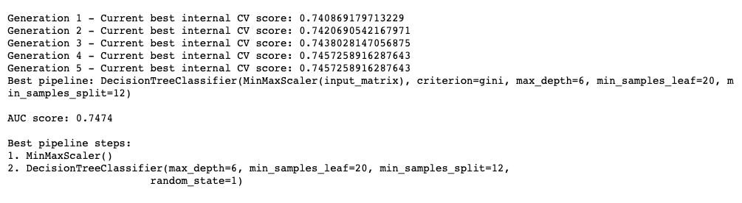
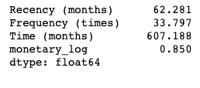
TRAINING & TEST MODELING
Split data into three sets, 5%, 20% and 2%
Training is the process of applying the available data to the chosen algorithms
For the project I will be using TPOT and Linear Regression
I will also find Correlation between Features
Training multiple models allow comparing and choosing the best performing model.
I ended up training 25 models in total with cross-validation

Slide 7
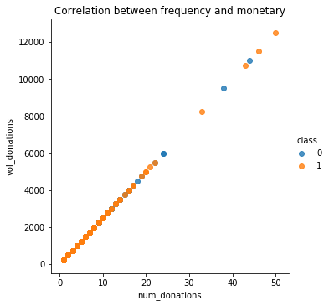
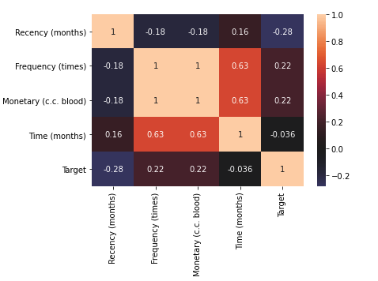
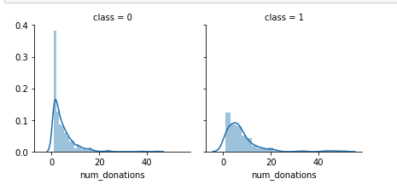
FEATURE SLECTION
We have a significative correlation with the class probability
notice that months distributions are not the same in the class 1 and class 0 subpopulations. Indeed, there is a peak corresponding to the people who have donated recently(in 1-2 months) will donate blood
You can see that Frequency and monetary values are highly correlated. So we can use only the frequency.

Slide 8
EVALUATION
Compared AUC, Accuracy, Precision, F1 and Recall scores between train and validation for generalization and between models for performance
Overall, scores were similar between both except for Precision, as expected, because the train data set was balanced, and the validation data set was not.
logistic regression
Support Vector Classification
Naive biar classification

Slide 9
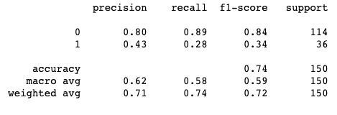
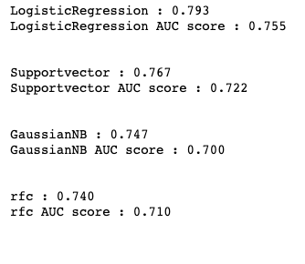
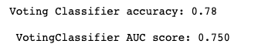
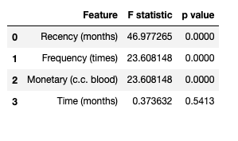
RESULTS

Slide 10
RISK & NEXT STEPS
Results in other slide shows prediction are accurate or close to donations donated each months
At this point of the analysis have achieved nearly 80% accuracy and hoping to get a better result from more cross-validation and methods
Exploring more options to use ensemble method to gain better accuracy
I will work on features as well to improve blood donations prediction

Slide 11
REFENCES
https://www.proglobalbusinesssolutions.com/six-steps-in-crisp-dm-the-standard-data-mining-process/
https://www.usatoday.com/story/news/health/2021/06/23/blood-banks-urge-donations-us-blood-supply-drops-demand-increases/5312985001/
https://machinelearningmastery.com/tpot-for-automated-machine-learning-in-python/
https://rdrr.io/cran/simpleNeural/man/UCI.transfusion.html

